Slide 1


Laboratory Health & Safety 2
Open Access Journal of Medicine and Healthcare (ISSN: 3068-7691)
By
Mls Nneka Patricia Anyaegbu
at
Diagnostic Department Gombe State Specialist Hospital Date: 23/1/25

Slide 2

Event Venue

Slide 3
Learning Objectives
To know different safety rules in the laboratory.
To learn how and when to use personal protective Equipment.
To always adhere to safety rules while working in the laboratory.
To start practicing segregation of hospital care waste from their facilities.
To start practicing waste decontamination before disposal by use of autoclave.
To know what to do in case of accident or emergency.

Slide 4

Why Laboratory Health and Safety?
Performing testing is a potential health hazard.
Infectious materials, hazardous chemicals and reagents are used to conduct testing
Safety Involves Taking Precautions To Protect:
Yourself.
Other people-your colleagues, other hospital staff and clients.
Equipment & supplies.
The community.
Environment

Slide 5
Laboratory Health & Safety
Health and safety is intended to bring about condition free from risk of injury or threat to our health and well-being.
This objective is not a natural state of a natural state of affairs.
“A laboratory is always considered as a relevant and essential part so far as the teaching of science and computer is concerned”
Every school has laboratories where students can perform researches, experiments or even learn new things with the help of internet facility• 11 jan 2019.Https;//www.Lebiond in>blog>imp.

Slide 6
Safe Laboratory Practices & Procedures
Tip 1: Ask yourself, “What am I working with? What are the hazards?”
Common hazards in the laboratory include; Animal, Biological, Chemical, Physical, and Radiological. If there is an accident or emergency situation involving these hazards:
(1) Seek immediate assistance if you are splashed by any of these materials, use running water from an eye wash station or emergency shower for at least 15minutes or until emergency assistance arrives and provides you with different instructions.

Slide 7
Safe Laboratory Practices and Procedures Contd
Tip 2: Be Prepared.
Attend all required laboratory safety training prior to the start of your research assignment or investigations.
Read all procedures and associated safety information prior to the start of an experiment.
Follow all written, SOP and verbal instruction
Ask for assistance if you need guidance or help.
Safe Laboratory Practices and Procedures Contd
Tip 3: Prevent Potential Exposure:
(a) Dress for work in the laboratory. Wear clothing and shoes that cover exposed skin and protect you from potential splashes.

Slide 8
(b) Never eat food, drink beverages, chew gum, or handle contact lenses in the laboratory.
(c) Use a chemical fume hood or bio safety cabinet, as directed by your supervisor.
(d) Do not leave active experiments unattended. Never leave anything that is being heated or is visibly reacting unattended.
Safe Laboratory Practices & Procedures:Tip4
Protect yourself, others, your Research and the Environment:
Practice good personal hygiene. Wash your hands after removing gloves before leaving the laboratory, and after handling a potentially hazardous materials.
Properly segregate and dispose of all laboratory waste.
While working in the laboratory, wear personal protective equipment-eye protection, gloves, laboratory coat-as directed by your supervisor.

Slide 9
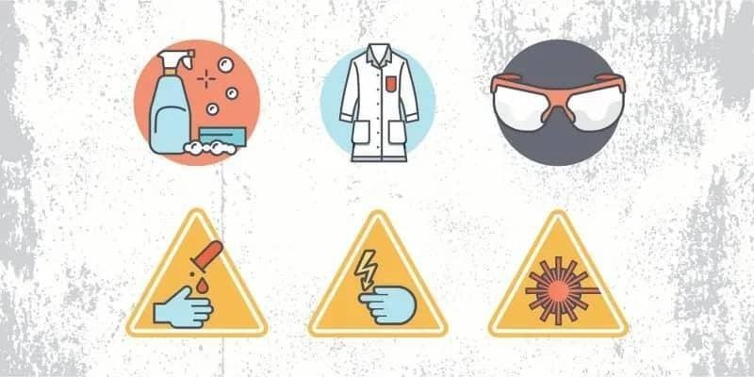
General Laboratory Safety Signages

Slide 10
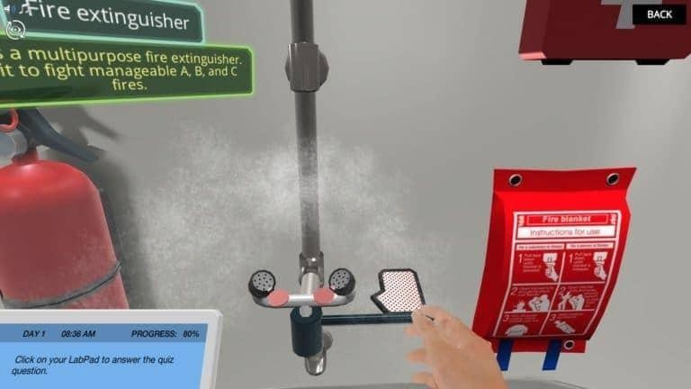
Some Laboratory Safety Equipment’s

Slide 11
Dress Code Rules
Always tie back hair that is chin-length or longer.
Make sure that loose clothing or dangling jewelry is secured or avoid wearing it in the first place.
Never wear sandals or other open-toed shoes in the laboratory, footwear should always cover the foot completely.
Never wear shorts or miniskirts in the lab.

Slide 12
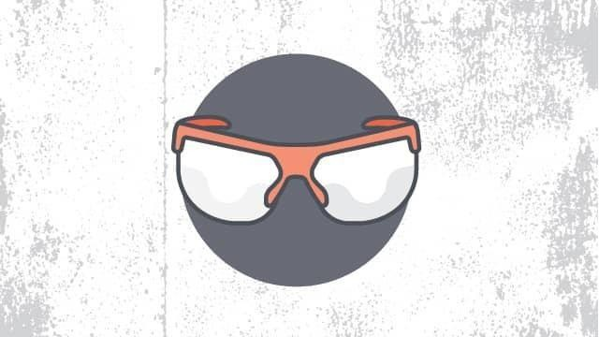
Diagram Of Personal Protective Equipment (Eye Goggle)

Slide 13
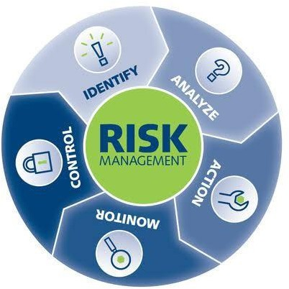
Risk Assessment

Slide 14
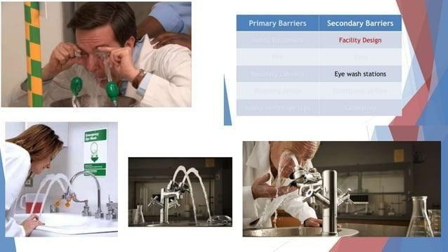
Eye Wash Station

Slide 15
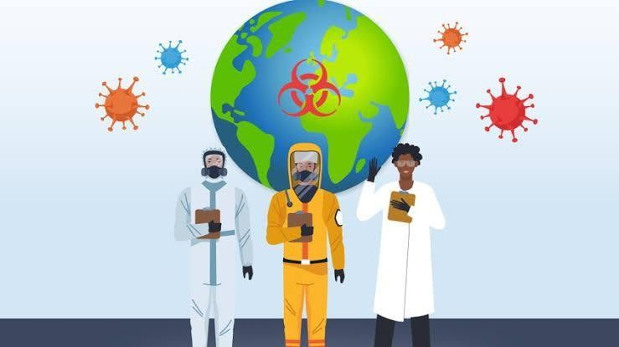
Professional Dress Code

Slide 16
Personal Protective Safety Rules
When working with equipment, hazardous materials, Glassware, heat and Chemicals, always wear face shields or safety glasses.
When handling any toxic or hazardous agent, always wear the appropriate gloves.
When performing laboratory experiments, you should always wear a smock or lab coat.
Chemical Safety Rules
Every chemical should be treated as though it were dangerous.
Do not allow any solvent to come into contact with your skin.
Water should not be poured into concentrated acid. Instead, pour acid slowly into water while stirring constantly. In many cases, mixing acid with water is exothermic.
Chemicals should never be mixed, measured or heated in front of your face.

Slide 17
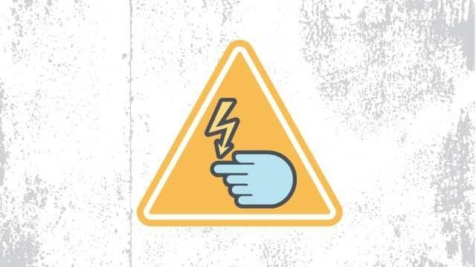
All chemicals should always be clearly labelled with the name of the substance, concentration the date it was received, and the name of the person responsible for it.
Diagram Of Electrical Safety Rules

Slide 18
Electrical Safety Rules
Before using any high voltage equipment (voltages above 50Vrms ac and 50Vdc), make sure you get permission from your lab supervisor.
High voltage equipment should never be changed or modified in any way.
Always turn off a high voltage power supply when you are attaching it.
Whenever you can, avoid using extension cords.

Slide 19

Laser Safety Rules Diagram

Slide 20
Laser Safety Rules
Always wear the appropriate goggles in areas of the lab where lasers are present. The most common laser injuries are those caused by scattered laser light reflecting either off the shiny surface of optical tables, the sides of mirrors, or off mountings. Eye Goggles will help you avoid damage from such scattered light.
Always keep the laser beam at or below chest level.
Laser beams should never be allowed to spread into the lab.
Beam Stops should always be used to intercept laser beams.
Do not walk through laser beams.

Slide 21
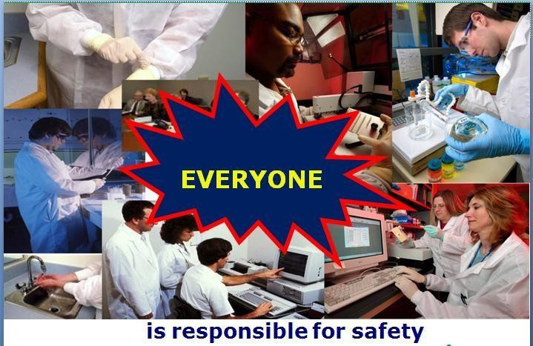
Diagram/Who is Responsible for Safety?

Slide 22
Why Safety?
Secondary effects of a laboratory accident:
Loss of staff confidence.
Loss of reputation.
Loss of customers.
Increased cost, Litigation, Insurance and
Death.
Negligence of Laboratory Safety is Costly!!!

Slide 23
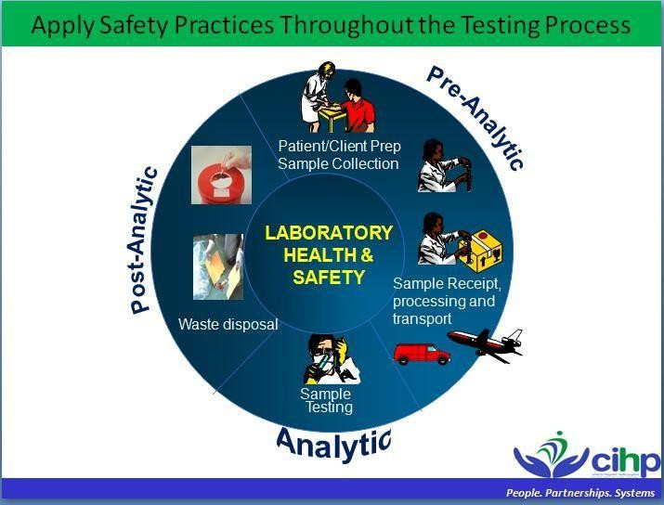
Apply Safety Practice Throughout The Testing Process. Diagram

Slide 24
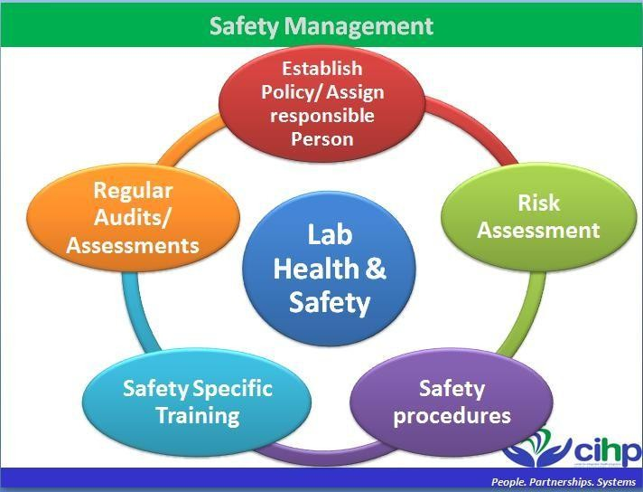
Safety Management Diagram

Slide 25
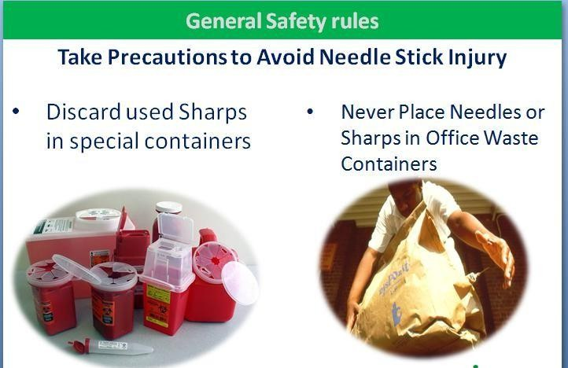
General Safety Rules: Take Precautions to Avoid Needle Stick Injury. Diagram

Slide 26
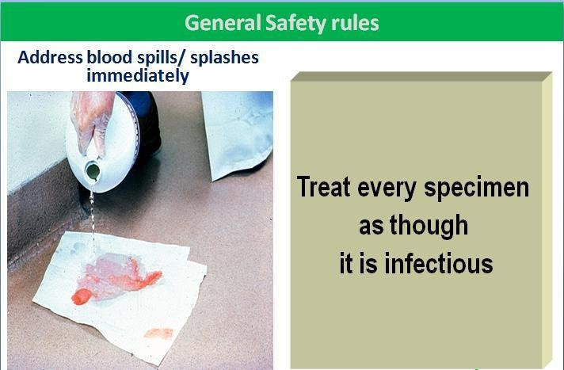
General Safety Rules: Address Blood Spills/Splashes Immediately. Diagram

Slide 27
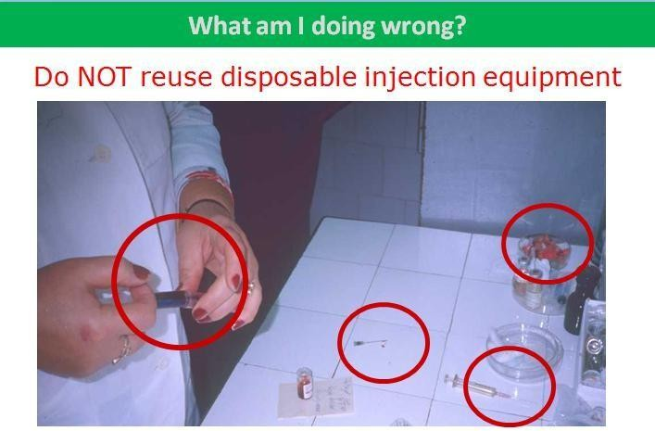
What am I doing wrong? Do not work without Hand Gloves: Diagram

Slide 28
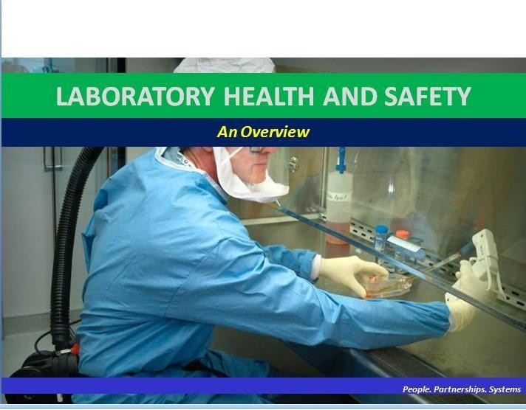
Dress code while working in the Laboratory

Slide 29
Conclusion
Neglecting Laboratory Safety is costly. It jeopardizes the lives and health of employees and patients and jeopardizes laboratory reputation, equipment, and facilities.
Recommendations
Ensure you are fully aware of your facility’s / building’s evacuation procedures.
Make sure you know where your lab’s safety equipment including First Aid kits, Fire extinguishers, Eye wash stations and safety showers-is located and how to properly use it.
Know emergency phone numbers to use to call for help in case of an emergency.
Make sure you are aware of where your lab’s exits and fire alarms are located.
Know the safety signage's and their meanings.

Slide 30
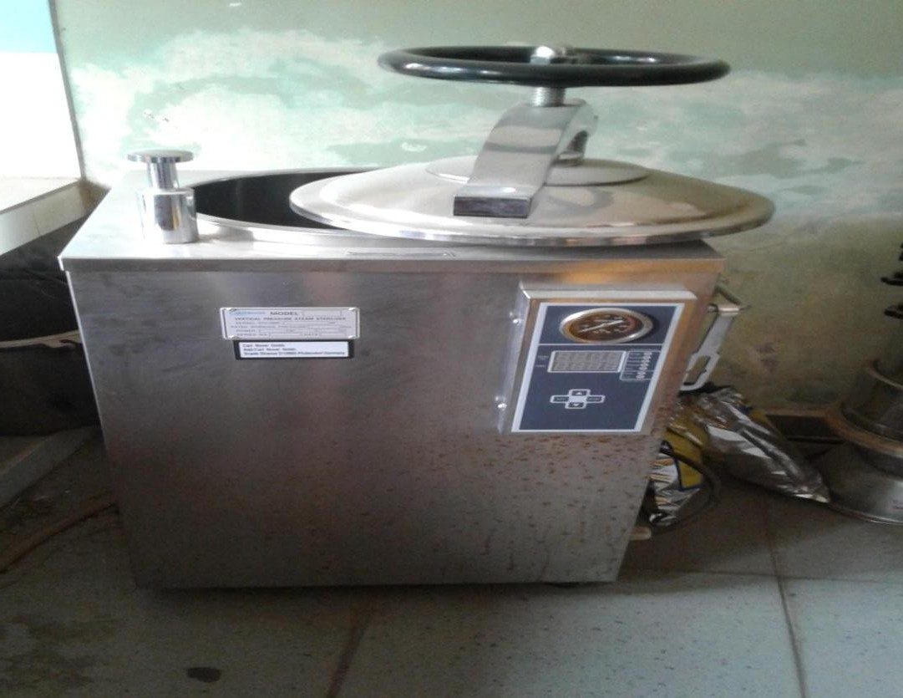
Autoclave Provided by the management to the lab for waste Decontamination of Hospital care waste before disposal

Slide 31
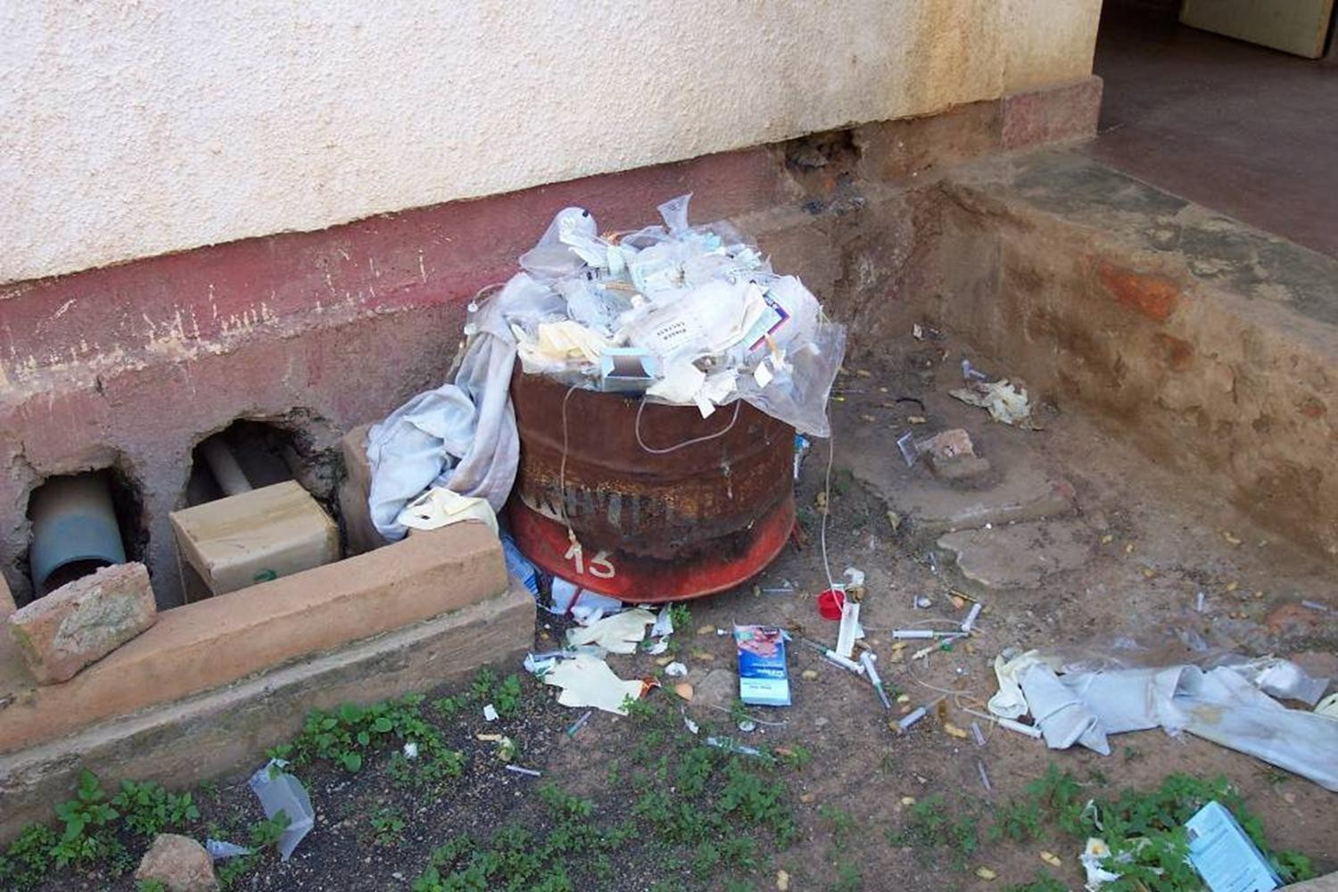
Indiscriminate disposal of Hospital Care wastes

Slide 32
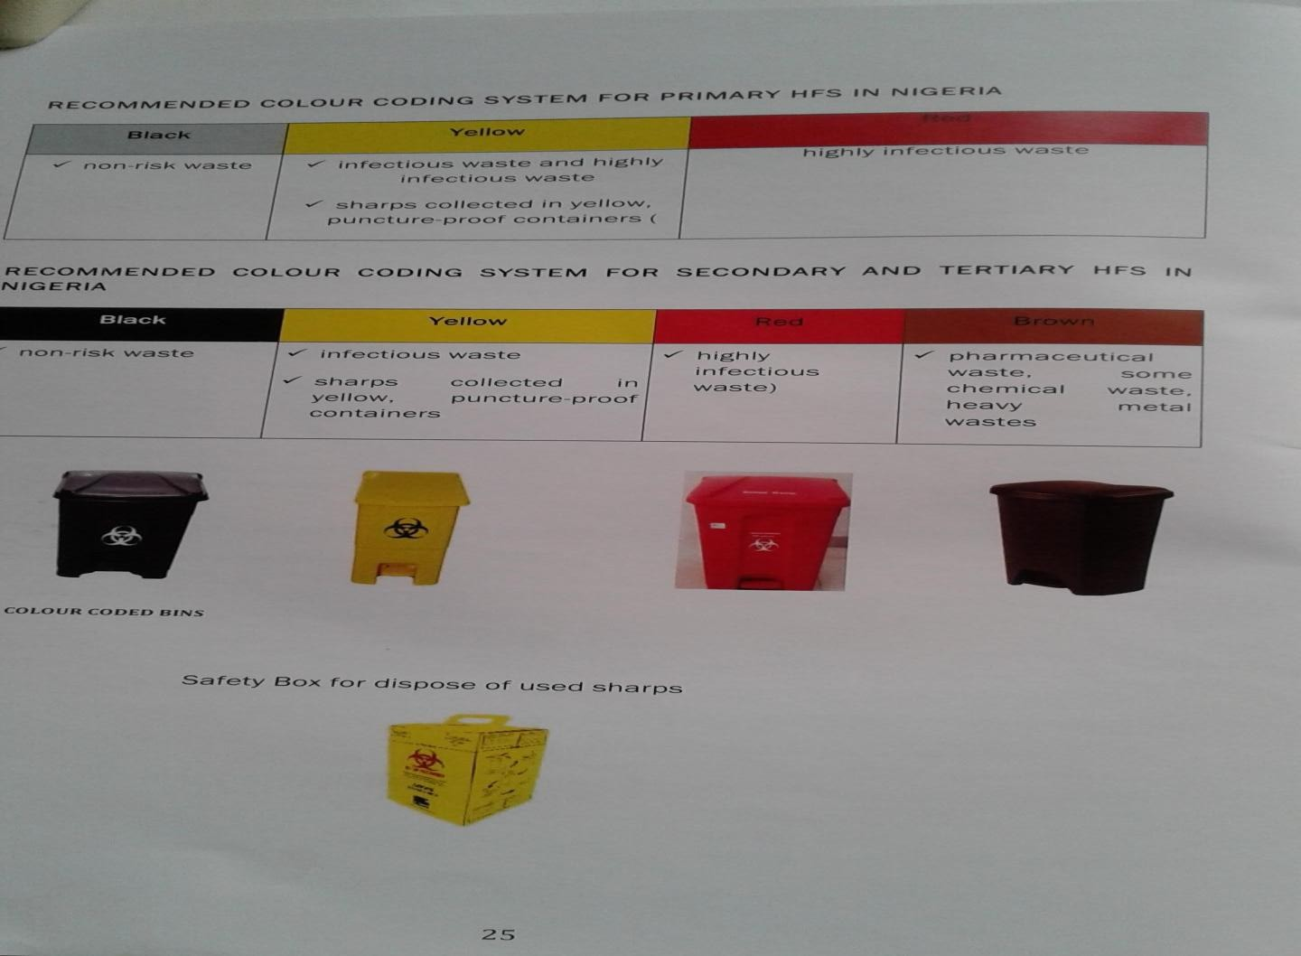
Color coding System of waste Segregation for Secondary and Tertiary Health Facilities in Nigeria

Slide 33
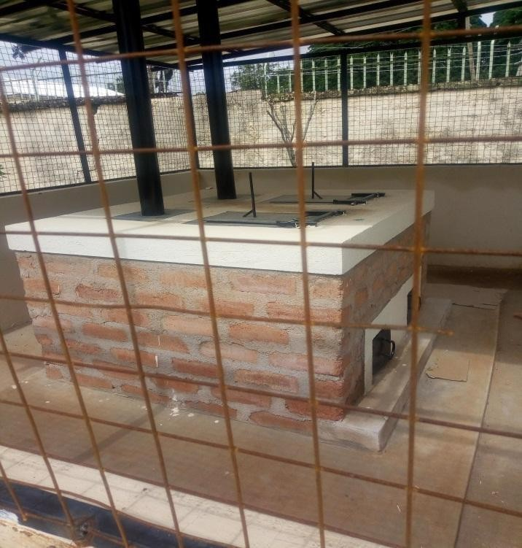
Locally made Incinerator for burning Hospital Care wastes

Slide 34
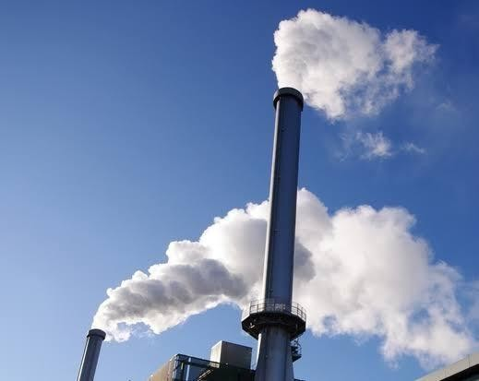
Another type of Incinerator

Slide 35

Thank You

Slide 36

Questions

Slide 37
References
https://www.lebiond in>blog>imp. 11 Jan 2019.
https://enwik.ibooks org>wiki>int.
https://ehs.stonybrook edu>programs.
https://www.elitechgroup.com>news.L
Lab Safety Guide-SUNY Stony Book. Environmental Health and Safety.
https://www.google.com/url?sa=web&source=web&rct=j&url=https://www’l abmanage
r.com/lab-health-and-safety/science-laboratory-safety-rules.
www.labmanager.com/lab health.
https://ors.d.nih gov>safety>pages (Safe laboratory practices & procedures- ORS, NIH.
https://lmglabmanager.s3.amazonaws.com/assets/articleNo/5727/almg/48879/ labsafetyrules1800x900-m.webp.

